Slide 1

Case Study Presentation
Presented by: Umashankar Lath
November 13th, 2022

Slide 2

Introduction
M.S in Data Science from University of Illinois, graduating in December 2022
Experienced Data science professional
Background – Machine Learning, Financial Analytics

Slide 3
Case Summary
Home lending mortgage company
Total number of leads in the data provided – 50K relating to a period of Five months
Data includes loan amount, time stamps, Marketing personnel, and State
Goal is to enhance the business processes and maximize the conversion rate of the sales team

Slide 4

Analysis Performed
Analysis Performed

Slide 5
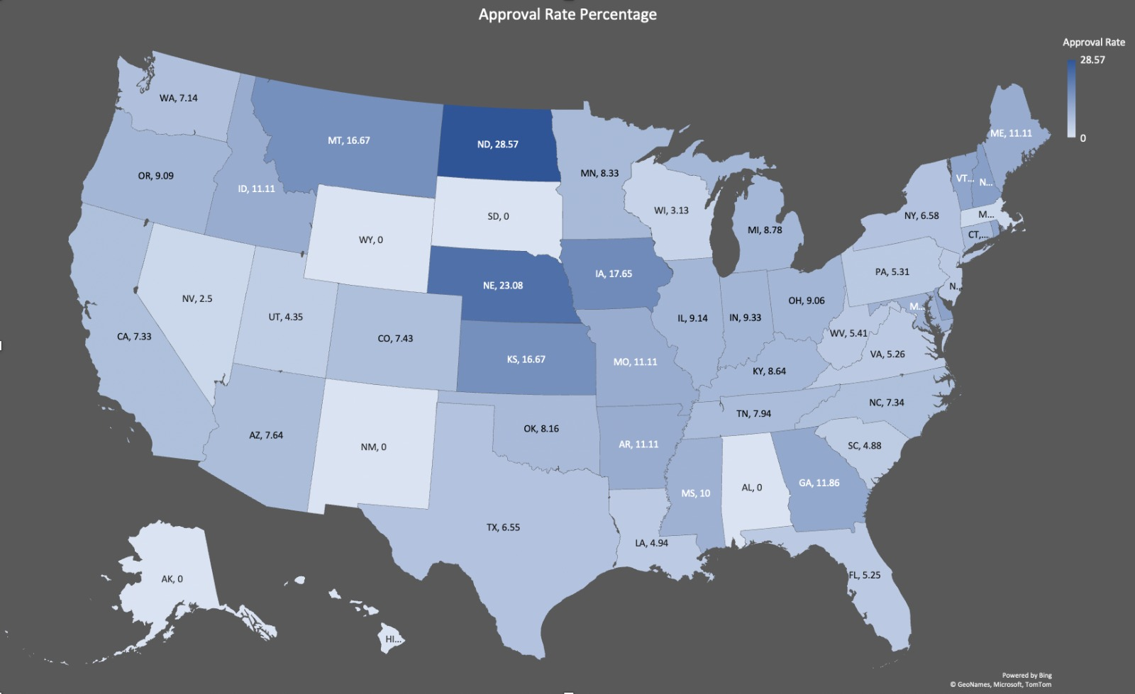
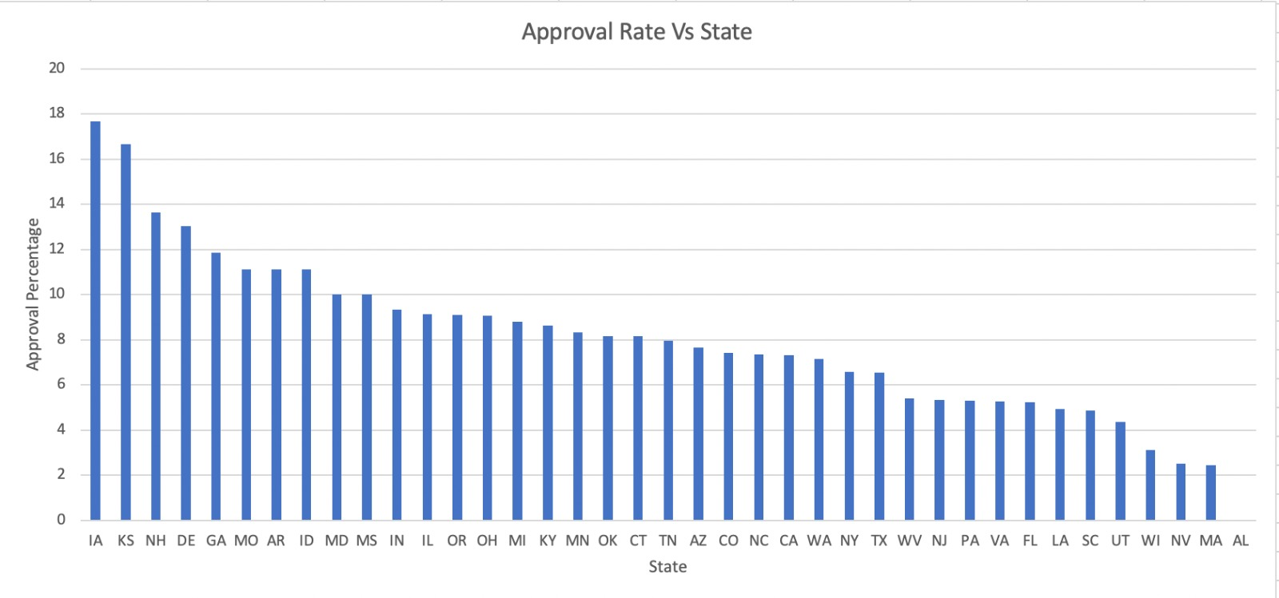
Location Analysis
Background:
Approval rate is computed for each state
Insight:
Top five states, in terms of approval, are – Iowa, Kansas, New Hampshire, Delaware, Georgia
States with least approval – DC, Alaska, Nevada, Wisconsin, Massachusetts
Approval Vs State
Assumption:
Nebraska, New Mexico, South Dakota, Maine, Hawaii are ignored as number of applications in these states are less than First Quartile

Slide 6
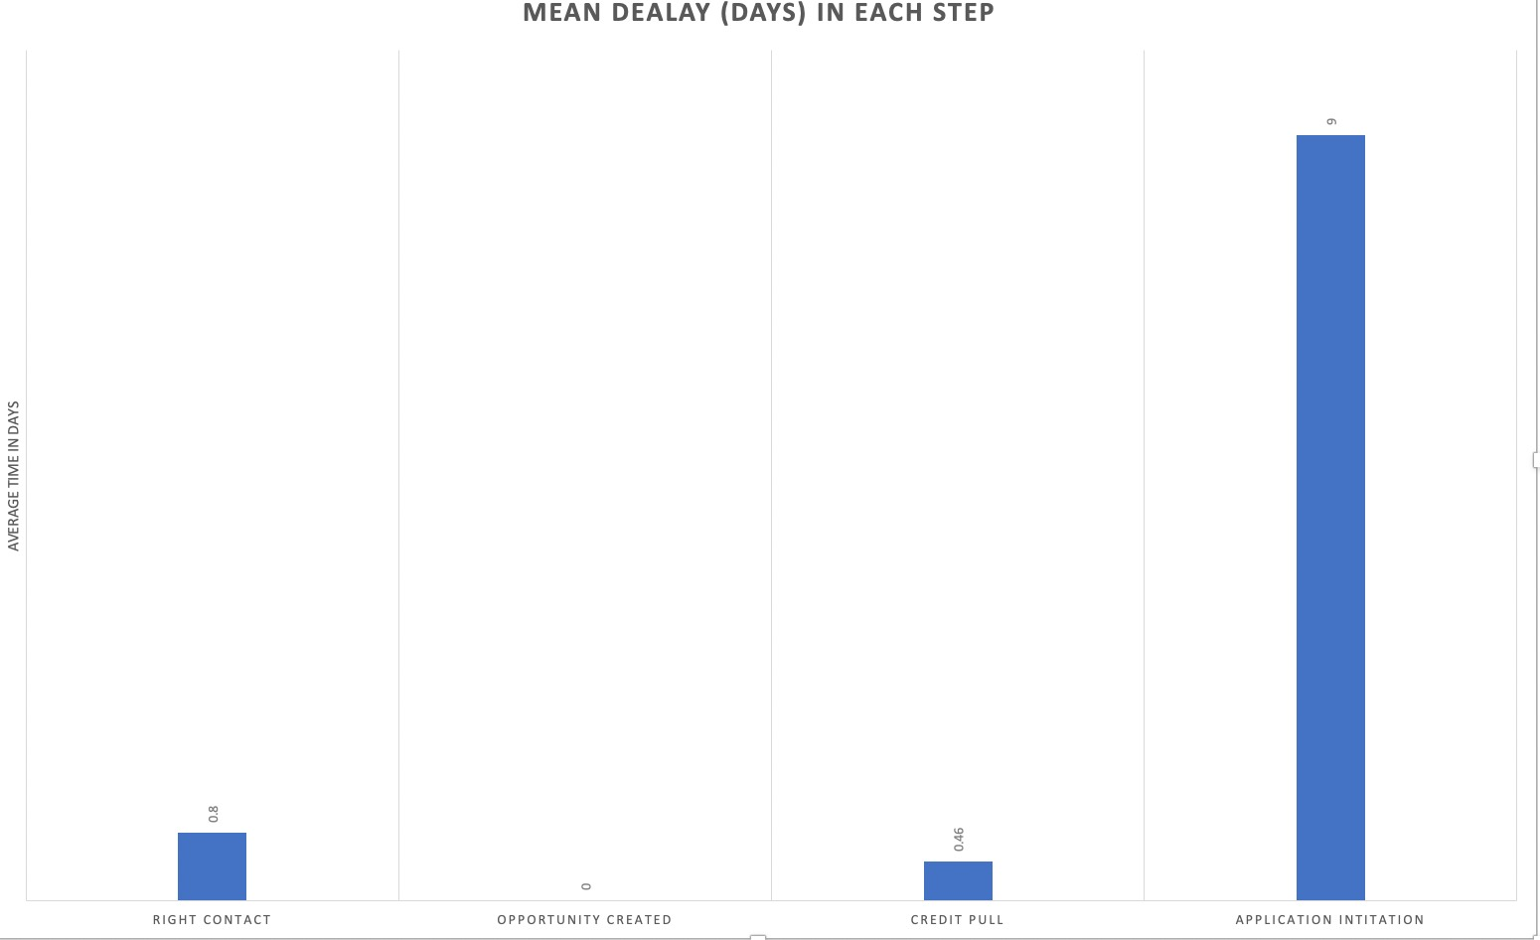
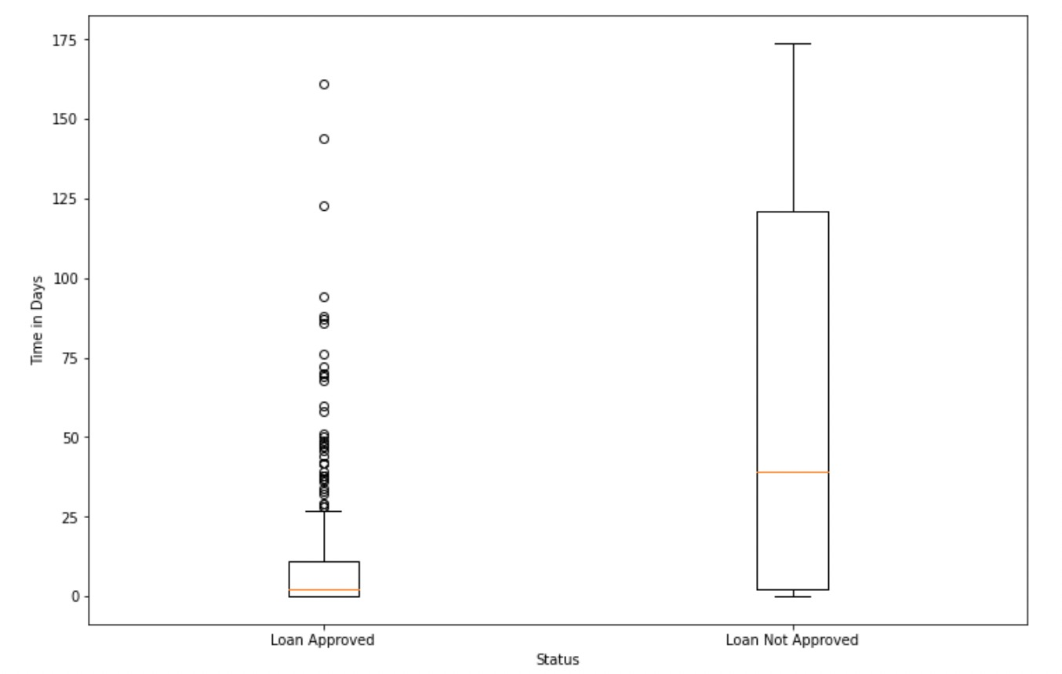
Lead Time
Background:
The time difference between the lead submission date and the lead exit date is calculated. For approved loans, the time delay for each step of the process is shown above.
Insight:
For approved loans, the bottleneck step is application initiation step
The mean time difference in case of approved loan is 10 days while for unapproved loan it is 57 days
Assumption:
For approved loans, the lead exit time is assumed as the application initiation date.

Slide 7
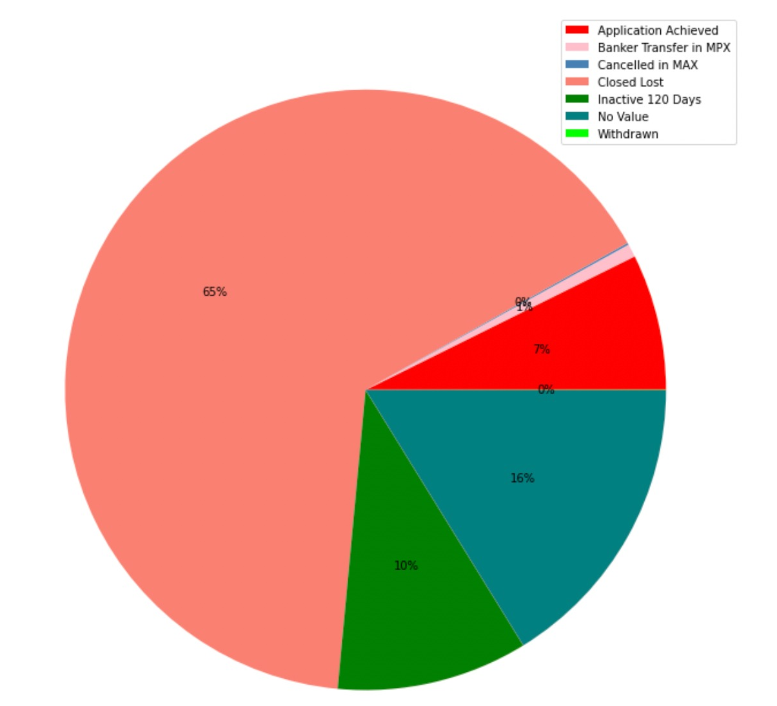
Application Status
Background:
Percentage Distribution of each application status is demonstrated.
Insight:
The application conversion rate is 7% and most applications are lost (65%)
A significant percentage of application, 10%, is inactive for 120 days
16% of all applications has no values
Three application status categories, i.e.,
"Cancelled by banker in MAX (Credit Pulled)", " Killed from MAX", "AUS Denied in MAX" are clubbed as one category.
Assumption:

Slide 8
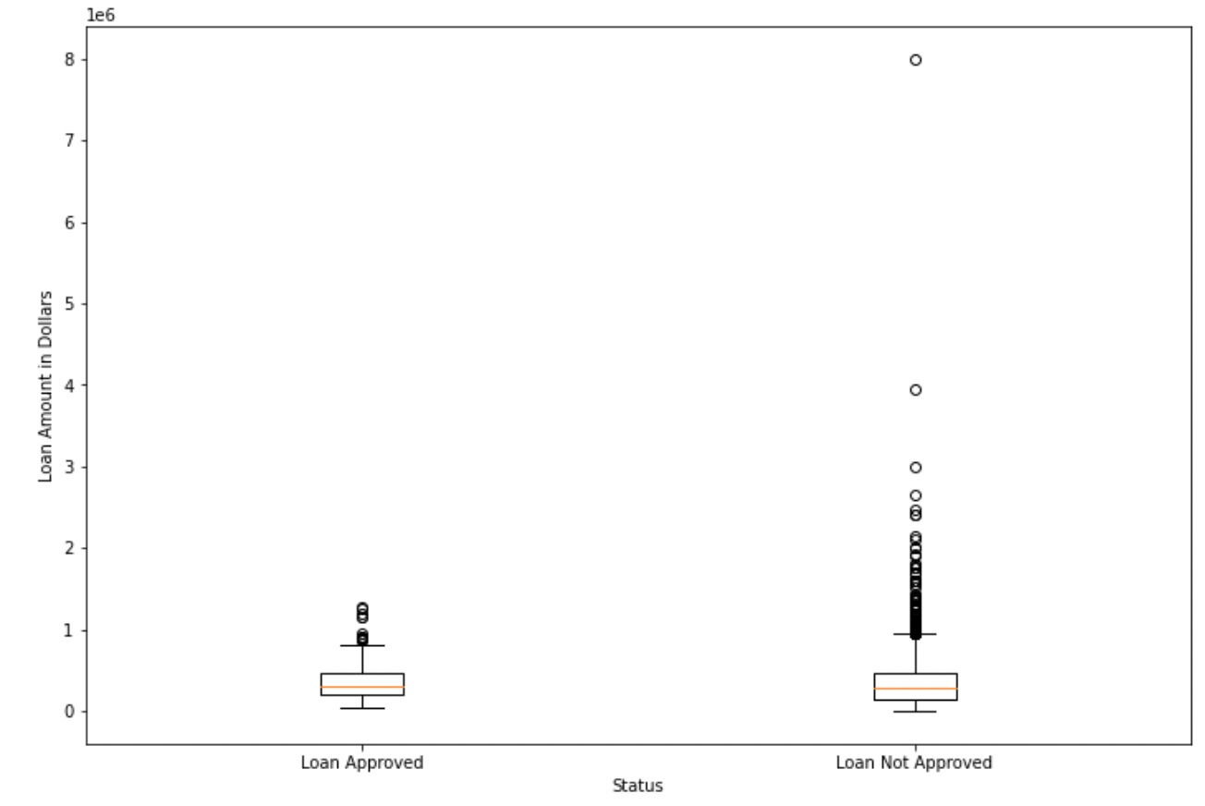
Loan Amount Variance
Background:
Skewness and spread in the loan amount for the approved loans and rejected loans is shown.
Insight:
The maximum loan amount approved is
USD 12,80,000
Rejected loans have higher variance in loan amount and multiple outliers
Assumption:
All the loans with status other than "Application Achieved" are assumed as rejected.

Slide 9
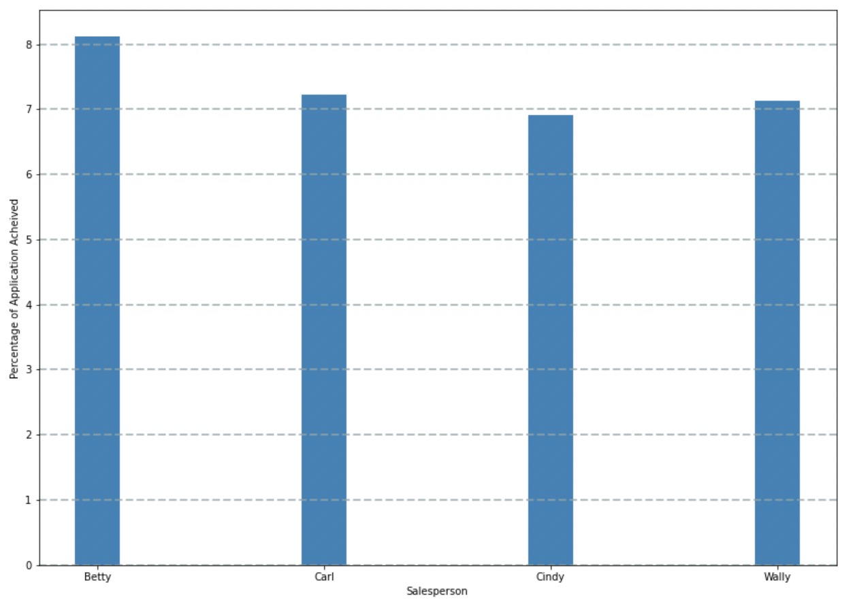
Performance Analysis
Background:
Application conversion rate of each marketing persona is critical parameter to assess individual performance.
Insight:
Betty has the maximum application conversion rate while Cindy has minimum conversion rate
Difference in application conversion rates among marketing personnel is not high, which implies everyone is performing at a similar level
Assumption:
Approval rate for each month is compared although we don't have full data for the month of October.

Slide 10
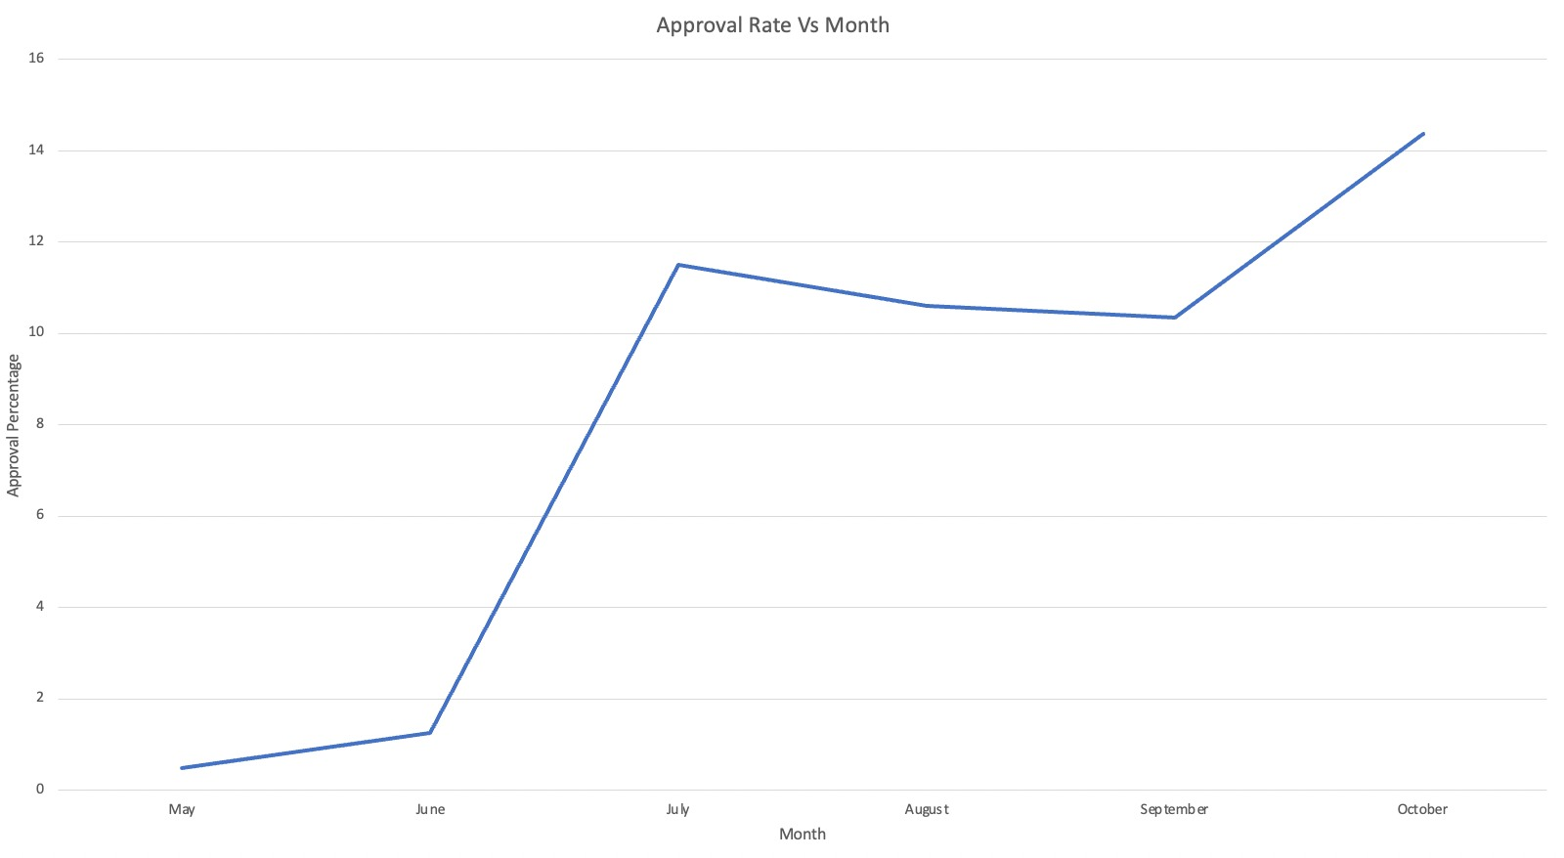
Month of Application
Background:
Monthly Application Conversion rate is assessed.
Insight:
May and June months have witnessed dramatically low approval rate (<2%)
October month has the highest approval rate, although, July, August, September, and October have similar approval rate
Assumption:
Only loans with "Application Achieved” status are assumed as positive conversion.

Slide 11
Recommendation
States with higher approval rates should be prioritized and vice versa.
The difference in the lead time for approved and rejected loan is significant, hence, It is critical to expedite application initiation stage, to increase the conversion rate.
Large portion of applications, classified as "Inactive 120 Days" and positive cases, have a mean lead time of 10 days, we need to aggressively pursue cases in the first 2 weeks to maximize conversion.
A way to identify or predict "No Value" and "Cancelled in MAX" cases early on in the process is essential to maximize conversion.
Loan amount of rejected applications have a higher dispersion and multiple outliers. Applications with loan amount in a particular range should be prioritized.

Slide 12
Thank You
Umashankar Lath
Email: ulath2@Illinois.edu
Contact: 2172003967

